Slide 1

3D ED-TECH
Sustainable Goal: Quality Education
Project Mentor: Mrs. Priyanka Shah
(Assistant Professor, Computer Engineering)
Group Number : 48
Group Members :
Mahek Kataria
Riya Laasi
Harshita Lohana
Gazal Keshwaani

Slide 2
Content
Introduction.
Survey of Existing System.
Limitations of Existing System.
Problem definition.
Architecture/ Framework (Block Diagram, Conceptual Diagram, ER Diagram).
Proposed System.
Methodology.
Details of Hardware and Software.
Results Obtained.
Conclusion.
References.

Slide 3
Introduction to 3D-EDTECH
We believe that learning should be an adventure that engages your senses and ignites your curiosity. Step into a realm where flat screens give way to the depth and excitement of three dimensions. Whether you're a budding artist, an aspiring engineer, or simply curious about the magic behind 3D creations, you've come to the right place. The mission of this website is
To demystify the captivating universe of 3D concepts
Empower learners of all ages and backgrounds to master this transformative technology.
Through a combination of interactive learning we're here to guide you through the journey of turning your imagination into reality.

Slide 4
Literature Survey
SR. NO. | TITLE | SUMMARY | YEAR | SOURCE LINK
1. | Influence of 3D Models and animations on students in natural subjects. | This study assesses whether dynamic visualization used in the experimental group has a stronger positive influence on the intrinsic motivation and learning outcomes of science students than static visualization used in control group. The result show that using 3d models and animations in the teaching process significantly increased the student’s intrinsic motivation for learning natural sciences. | 2022 | https://stemeducationjournal.springeropen.com/articles/10.1186/s40594-022-00382-8
2. | Student Perceptions using Augmented Reality and 3D Visualization Technologies in Chemistry Education. | This article discusses how Modern Computational technologies have revolutionized education, including the visualization of molecular geometry in chemistry. The authors developed several 3D animations of Fundamental chemical transformation aimed at organic chemistry courses. These animations became the basis for the 3D augmented reality tool called ARchemy. | 2020 | https://link.springer.com/article/10.1007/s10956-020-09880-2
3. | 3D Animation in Education | This article discusses how 3D educational animation ca be used to enhance learning. It suggests that these types of assignments can help mold the future of academia. | 2017 | https://pixelperfect-studios.com/3d-animation-future-education/

Slide 5
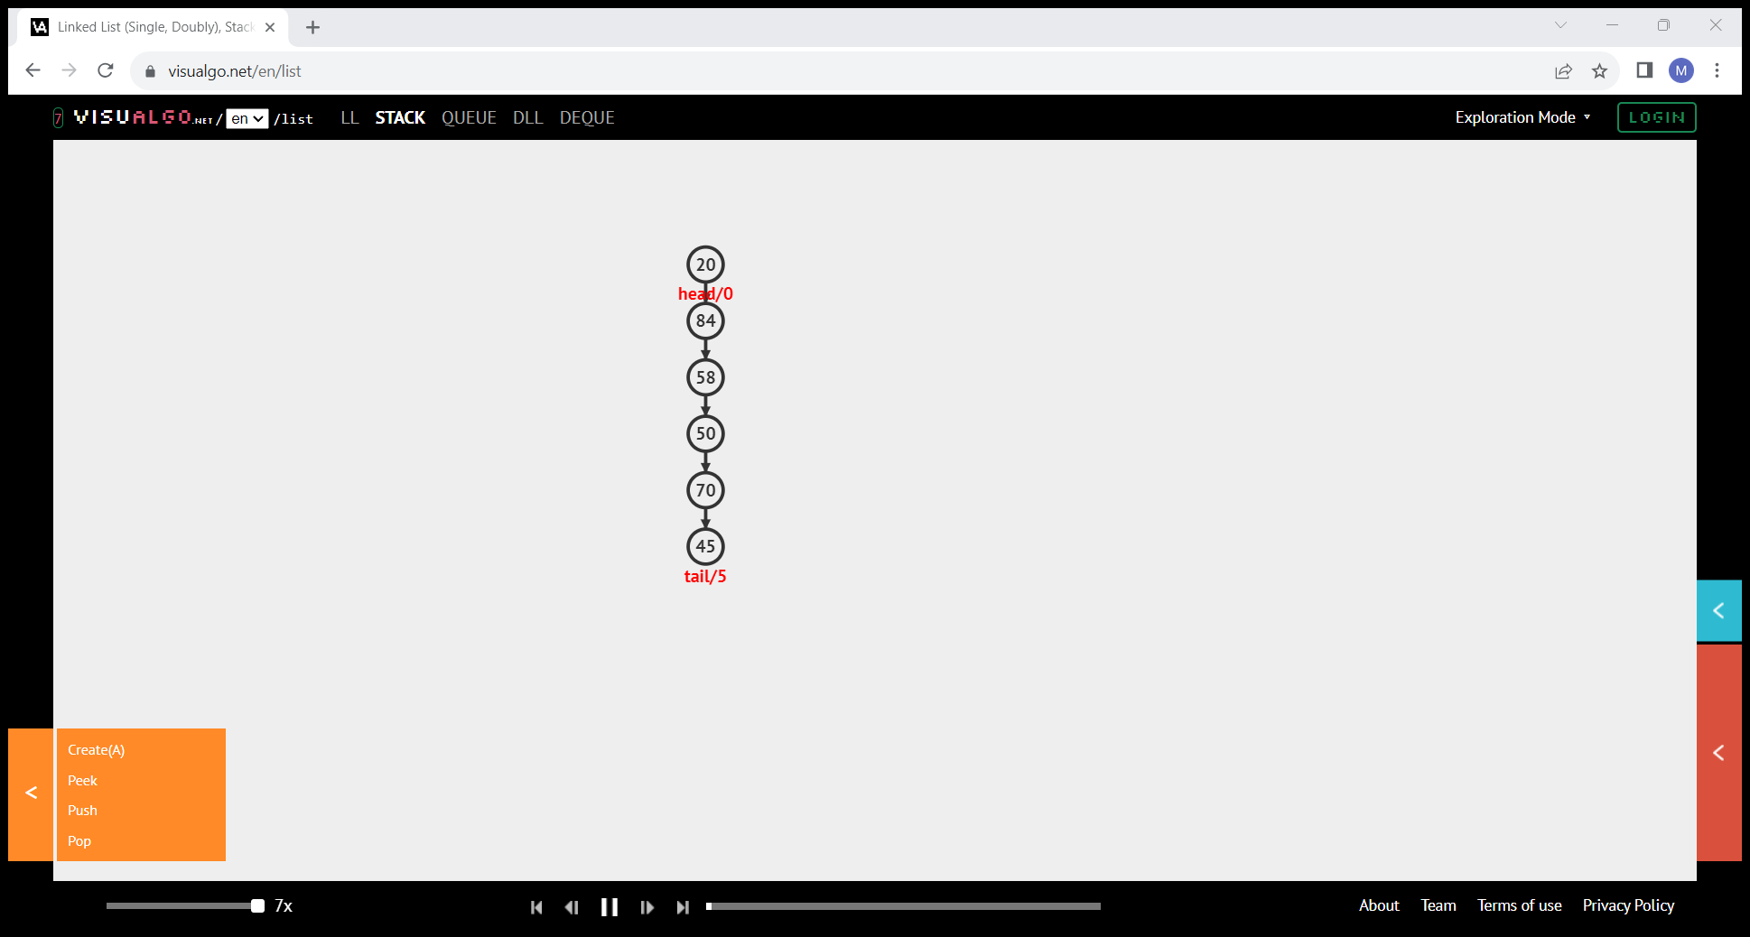
Limitation of Existing system
The Limitation in Existing System are:
Lack of Depth and Perspective
Difficulty in Visualizing 3D Concepts
Complex Processes and Systems
Real-World Context
Static Representations

Slide 6
Problem Definition
3D Quiz can accurately represent depth and perspective, enhancing the understanding of complex three-dimensional concepts. For example, a 3D Quiz of a tree data structure can show how nodes are connected in multiple directions, providing a more intuitive understanding.
With 3D visualization, complex concepts like Stacks or Linked Lists can be better understood as they can be represented in three-dimensional space. For instance, visualizing how nodes are connected in a linked list or how elements are stacked in a stack data structure becomes more intuitive in 3D.
3D visualization can make learning complex processes, systems, or procedures easier as it can accurately convey the sequence of events or the interaction between components. For example, understanding how an algorithm works step-by-step becomes more intuitive with dynamic 3D visualization.
3D Quiz allows for the simulation of real-world scenarios, enhancing understanding and application. For instance, seeing how a particular data structure or algorithm would work in a real-world application can enhance understanding.
Unlike 2D formats, 3D visualizations are dynamic and flexible, making it easier to demonstrate processes that involve motion, change over time, or cause-and-effect relationships. For example, showing how data changes over time in a data structure or how an algorithm progresses through its steps becomes more intuitive with dynamic 3D visualization.

Slide 7
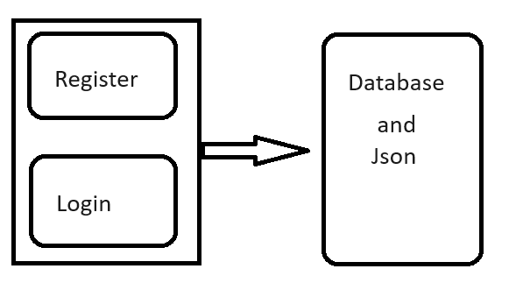
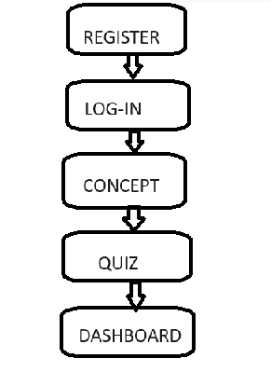
Architecture/ Framework (Block Diagram, Conceptual Diagram, ER Diagram)

Slide 8
Proposed System
1) 3D EdTech Visualization Platform ➡the Central element, representing the main project.
2) User Interface(Web Application) ➡ The interface that users interact with, providing access to animation explanation and search functionality.
3) Content Management(Database) ➡ The database stores login details of the user
4)3D Animation Engine ➡The engine integrates 3D quiz and animations with the user interface, allowing users to interact with visual representations of concepts.
5) Visual Explanations ➡ Comprehensive dynamic explanation of the concept along with algorithm.
6)Dashboard➡Shows the Progress of the user.

Slide 9
Methodology : Algorithm and Process Design
The development process involves several stages, including:
i)Visual Explanation and suitable 3D quiz.
ii)Creation of 3D Quizes and animation to represent various data structures.
iii)Development of an intuitive user interface of seamless navigation and exploration.
iv)Integration of Visual explanand relevant Algorithms alongwith animated Quizes
v) The user first creates an account on the website and signs up using a mobile number or email. Then, the user will be guided to an interface where they can select the topic that they want to learn along with animated quizes to enhance their knowledge regarding the topic.
vi) Then we have integrated a Dashboard indicating progress of the user.

Slide 10
Hardware, Software, Tools and constraint
HARDWARE:
Computer system with suitable specifications for software development and 3D Animation.
SOFTWARE/TOOLS:
Html
Css
Javascript,
Node.js
bootstrap and
Json

Slide 11
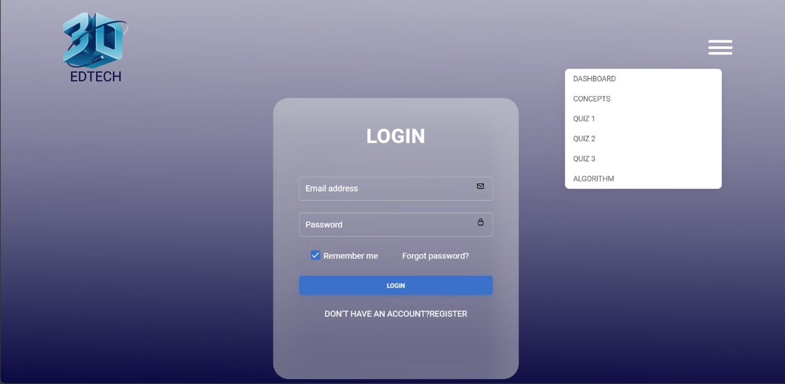
Results Obtained

Slide 12
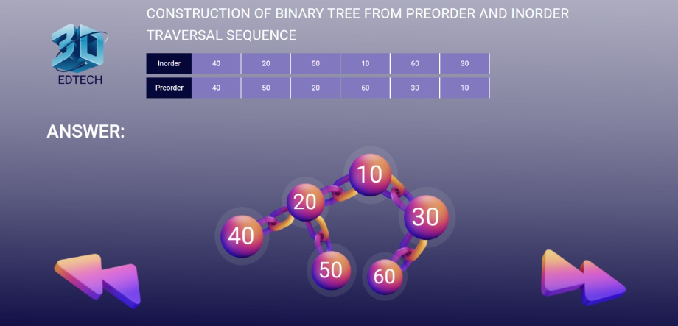
Results Obtained

Slide 13
Conclusion
3D EDTECH is a website that provides 3D Quizes and Visual Explanation of data structures and other technical concepts specifically for engineering students.
It is seen that many students struggle to understand the concepts which needs imagination in classroom learning. (3D EDTECH) which provides the 3D visualisation of such concepts.
3D EDTECH is effective and cost-efficient as it is a free source of learning which increases the student access to the subject.
3D EDTECH can lead to improved outcomes and high student satisfaction ratings.

Slide 14
References
VisuAlgo:
https://visualgo.net/
Geeksforgeeks.(for theory content): https://www.geeksforgeeks.org/datastructures/
Professor David Galles’ of San Francisco’s visualizer. https://www.cs.usfca.edu/~galles/visualization/Algorithms.html
Sorting Algorithms Animations.
https://www.toptal.com/developers/sorting-algorithm

Slide 15
THANK YOU !!

